Slide 1
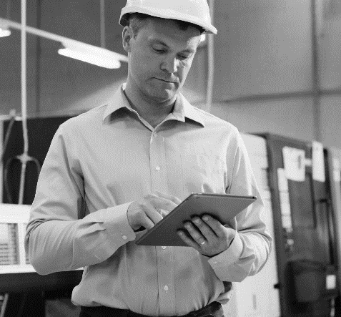
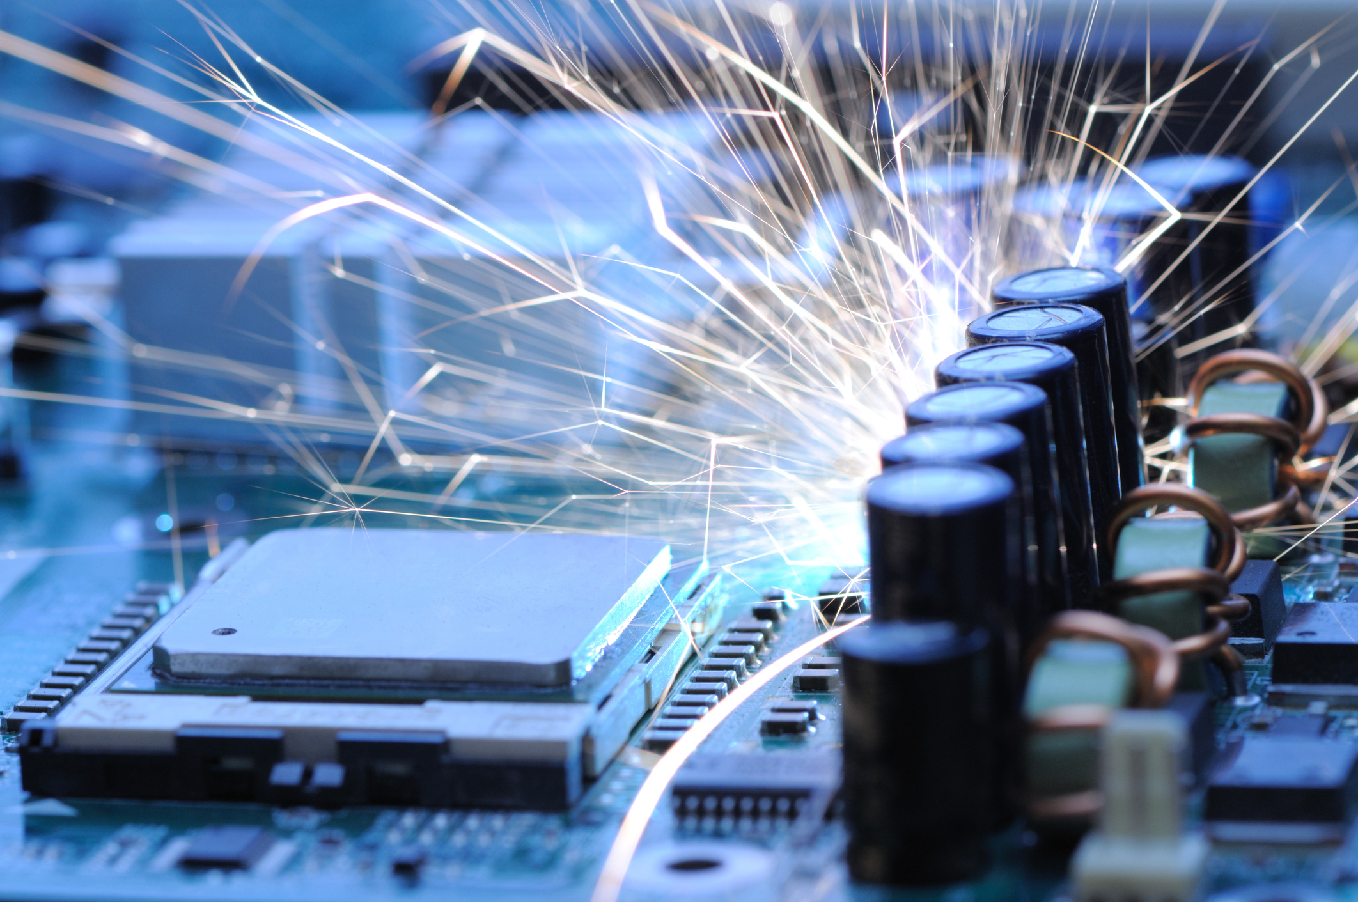
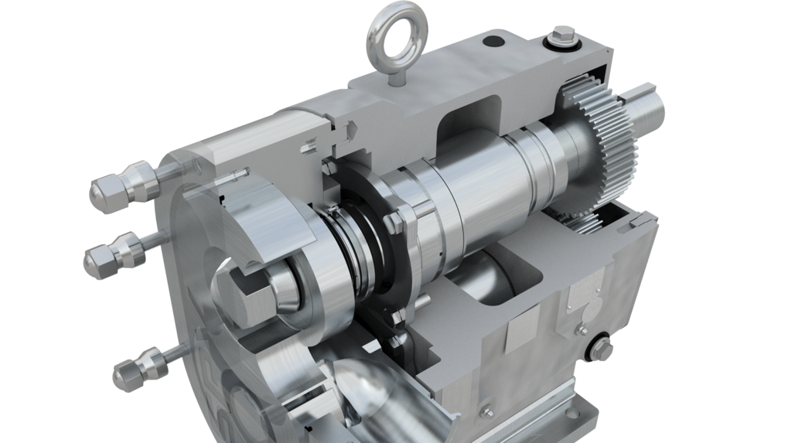
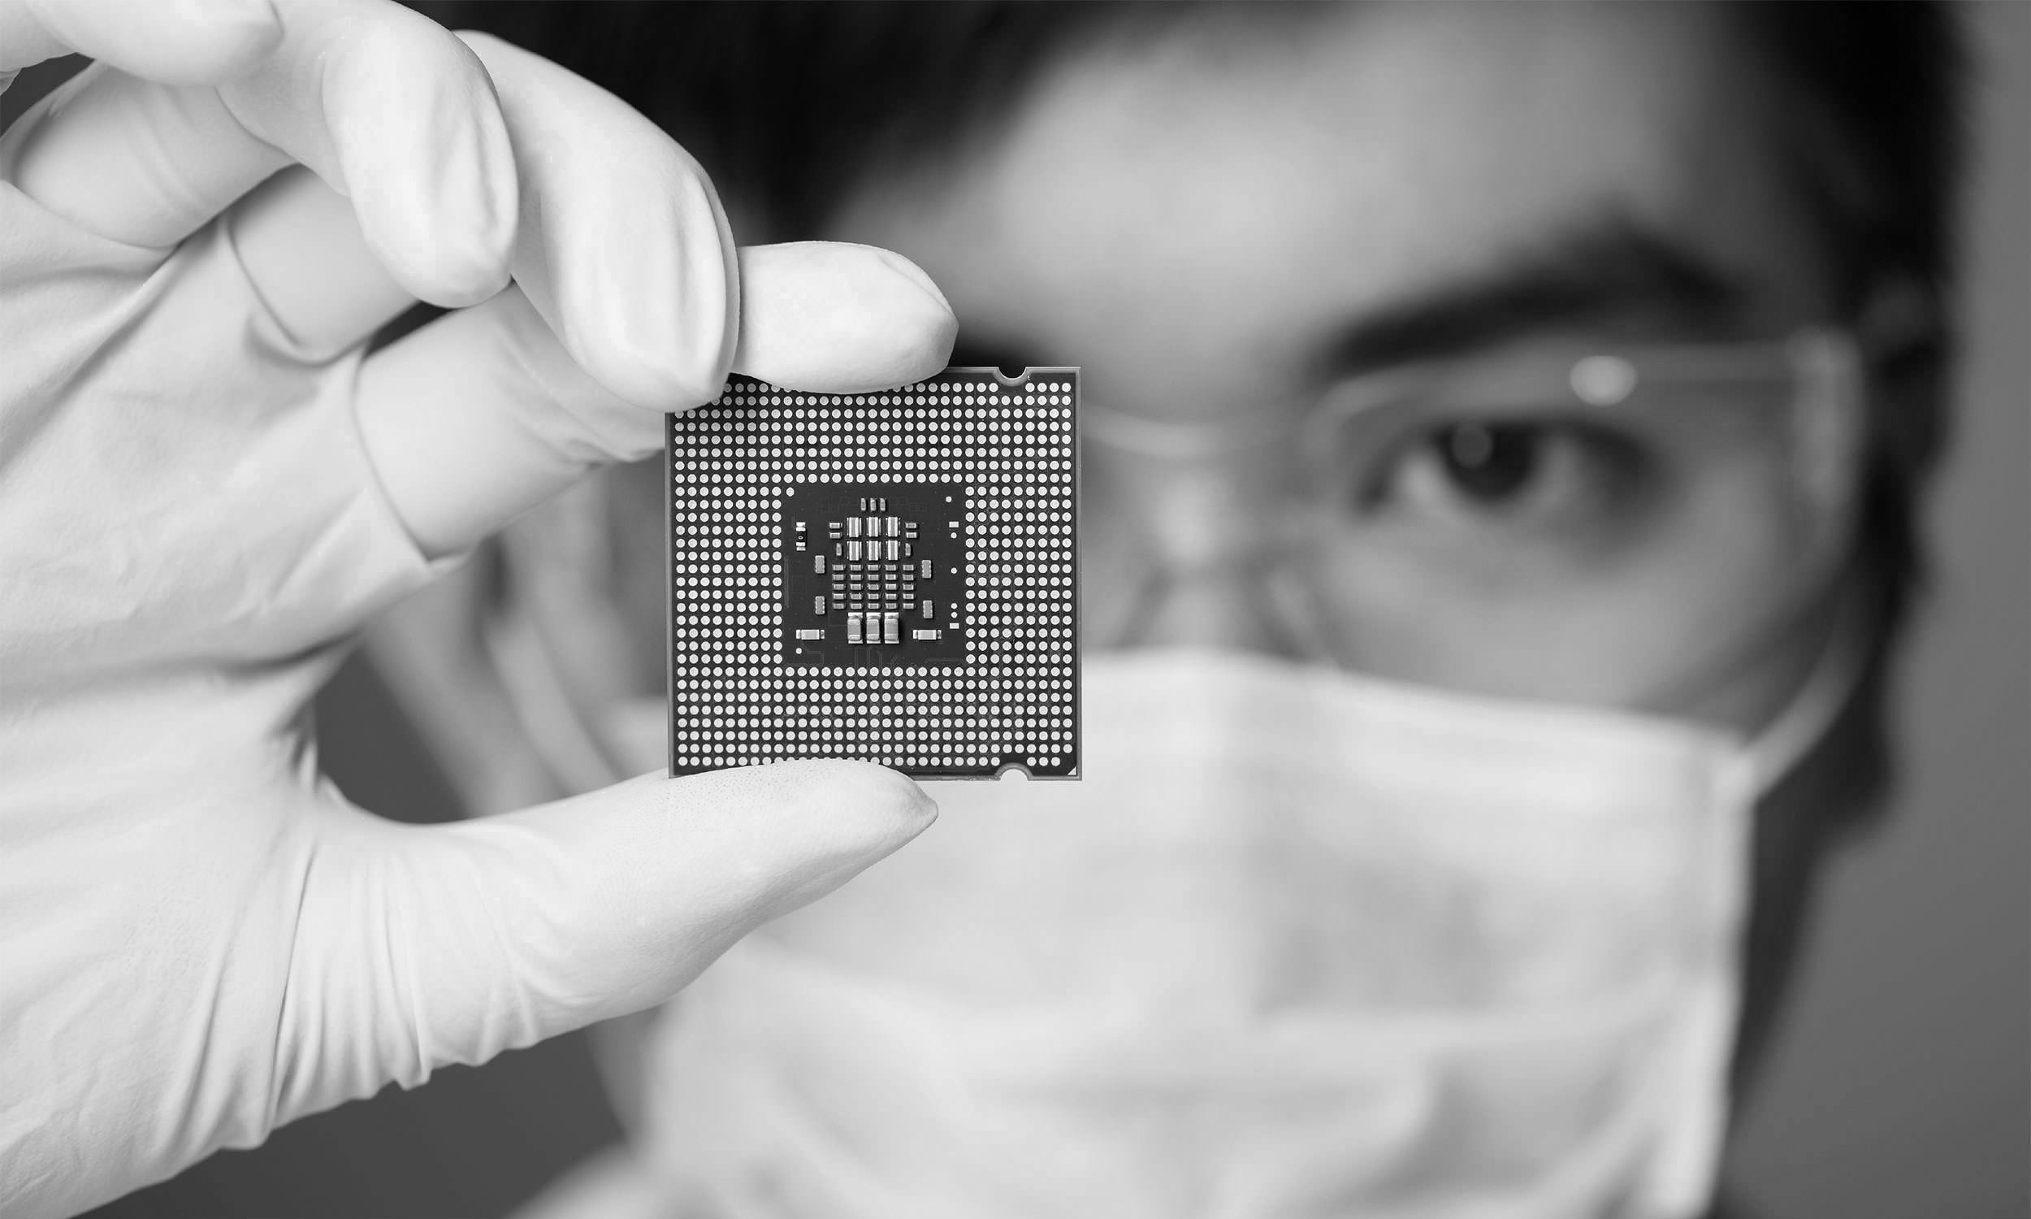
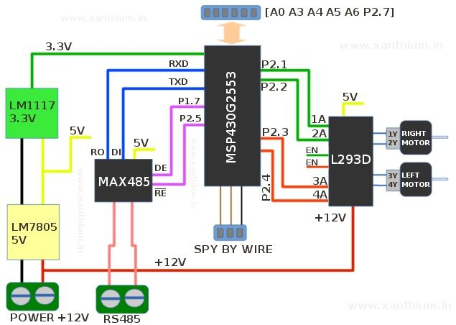

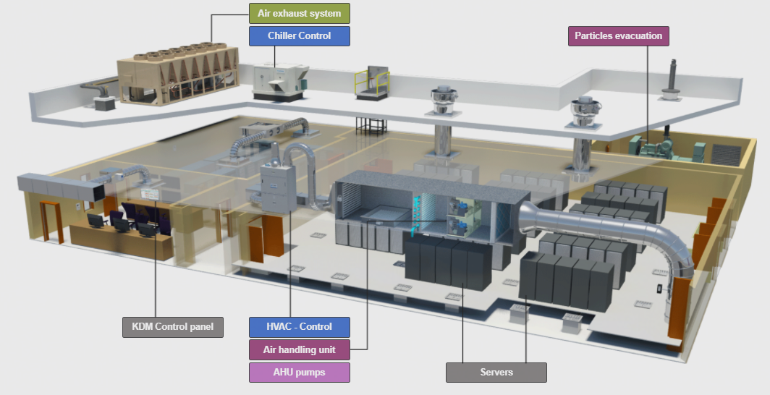

KIAMI
AI-based Troubleshooting & Knowledge Management
Much faster failures’ diagnosis and repair and
best-practice collaboration in manufacturing teams
www.kiami-solutions.com
1

Slide 2


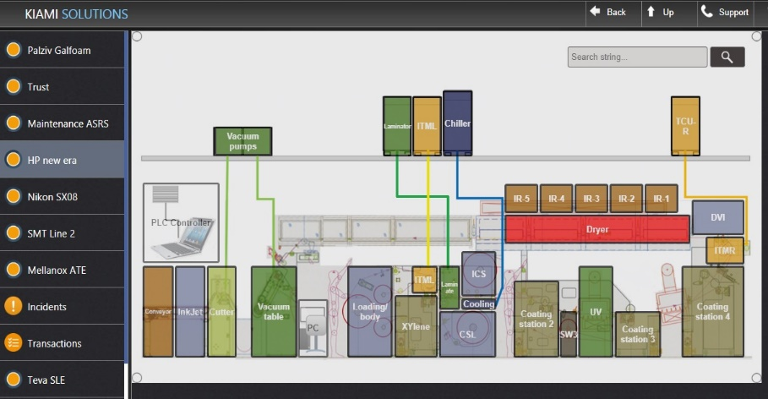
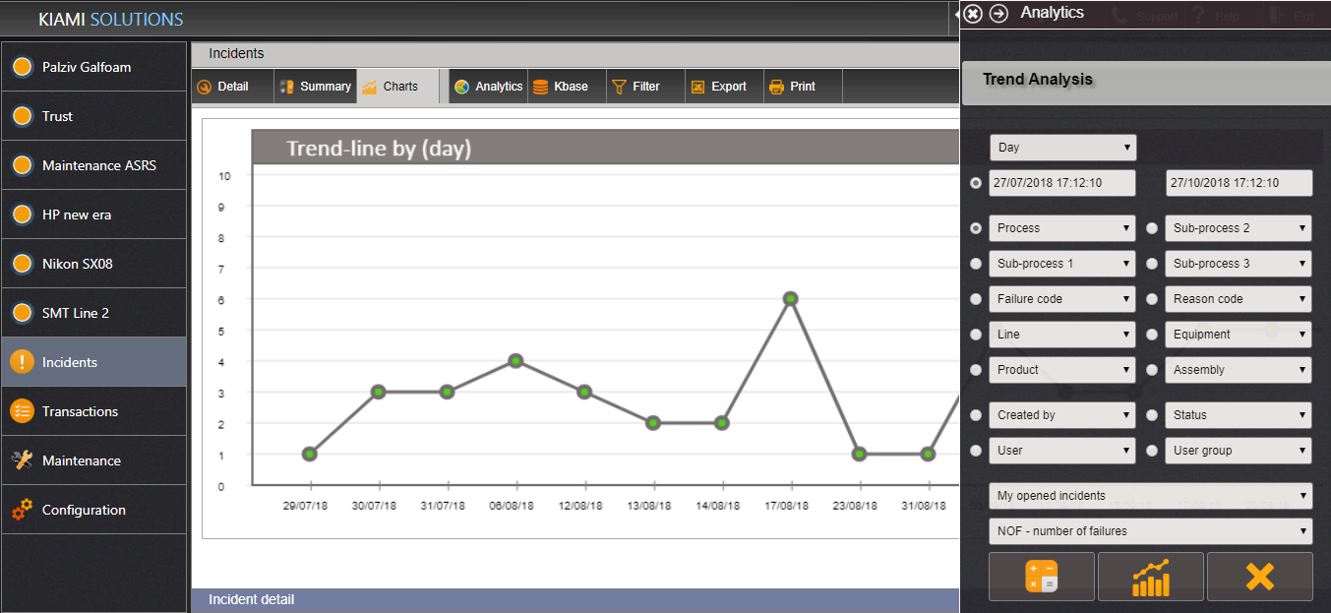
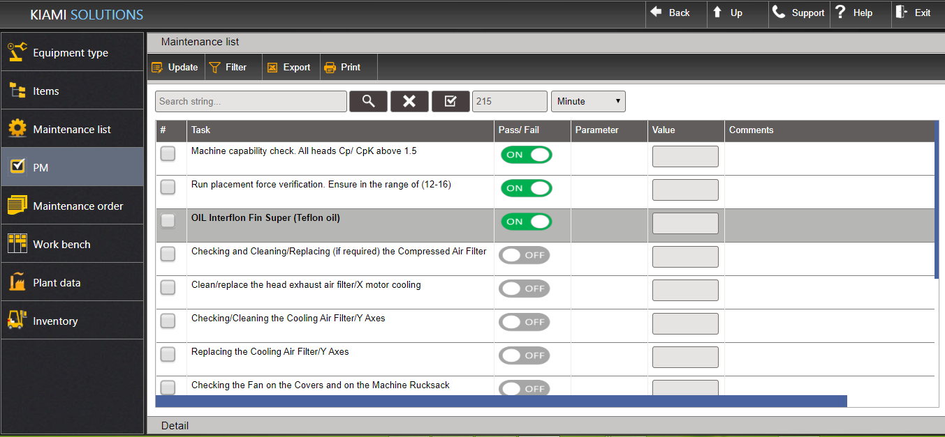
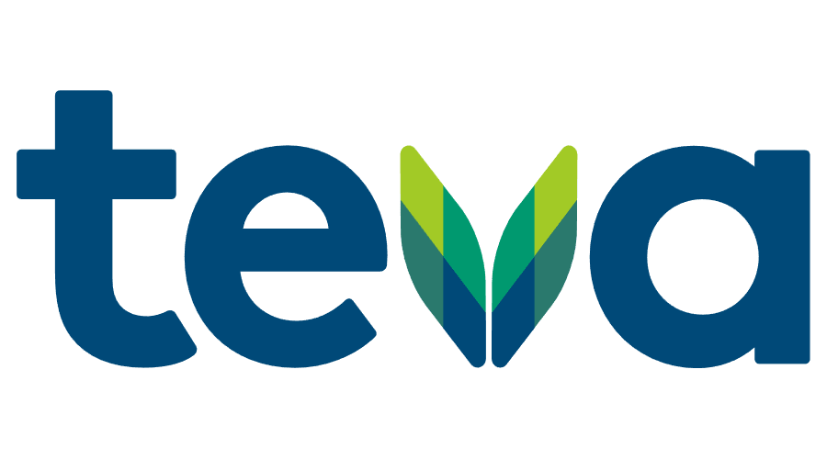



About Kiami
Manufacturing Experience
Lean, Six-Sigma, SPC, DOE
Innovated Expert Systems
Patent WO2005013016A3
Smart Troubleshooting +
Knowledge Management
Incidents Management
+ Analytics
Maintenance
Management
KIAMI
www.kiami-solutions.com
2

Slide 3
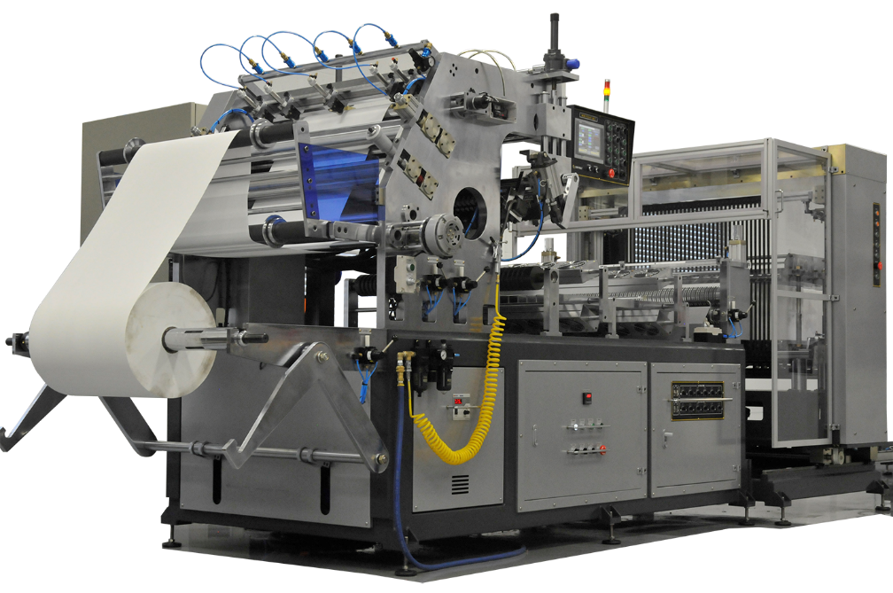

Manufacturing
failures can
kill your
bottom-line!
Downtimes
Materials waste
Poor quality
Spare parts costs
Manpower
KIAMI
3

Slide 4

What are your
pain-points?
Equipment,
Products and
Process failures
Long and inefficient repair process
Non-optimal trial and error
Expensive parts over consumption
Simple failures tend to complicate
20-50% due to setup & operators’ faults
Downtimes are two-three times longer than anticipated!
KIAMI
4

Slide 5
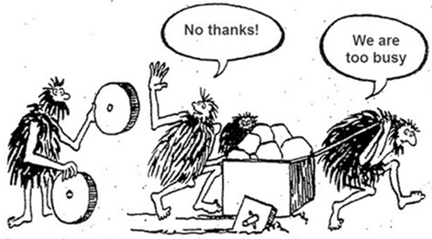
Technical
teams’
challenges
Prior-experience & best-practice are rarely reused
Ineffective knowledge sharing – teams and sites
Long new technicians’ learning curve
Highly dependent on internal / external experts
Knowledge loss due to experts’ departure/ retire
KIAMI
5

Slide 6


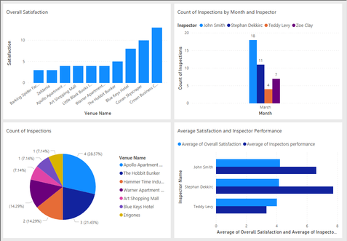
Kiami's
Troubleshooting
& Knowledge
Management
AI
BI
KNOWLEDGE
MANAGEMENT
+
+
Much faster failures’ diagnosis & repair
Repair optimization: time and parts’ costs
Virtual Expert for non experts’ self-support
Global knowledge collaboration
KIAMI
6

Slide 7
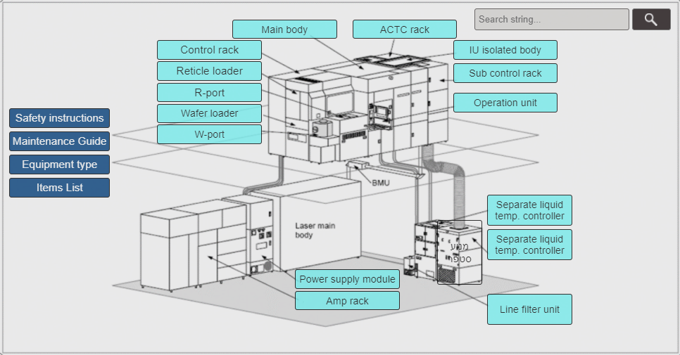
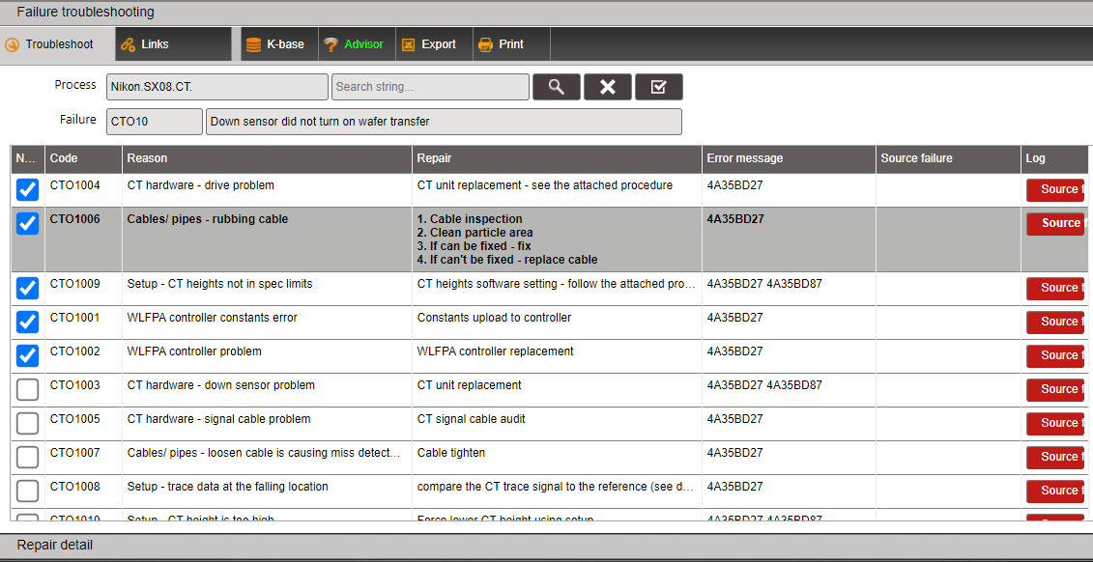
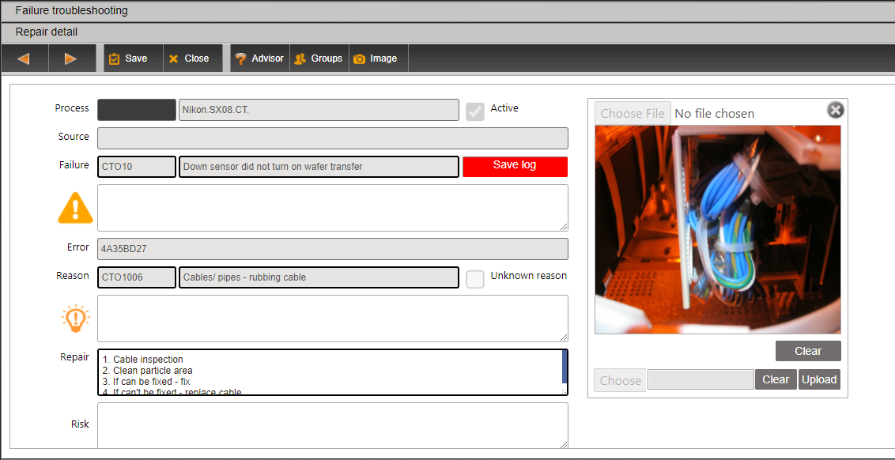
Kiami’s
Solution
A POWERFUL KNOWLEDGEBASE
is built around your equipment and processes
FAILURE
ROOT-CAUSE
REPAIR
KIAMI
7

Slide 8
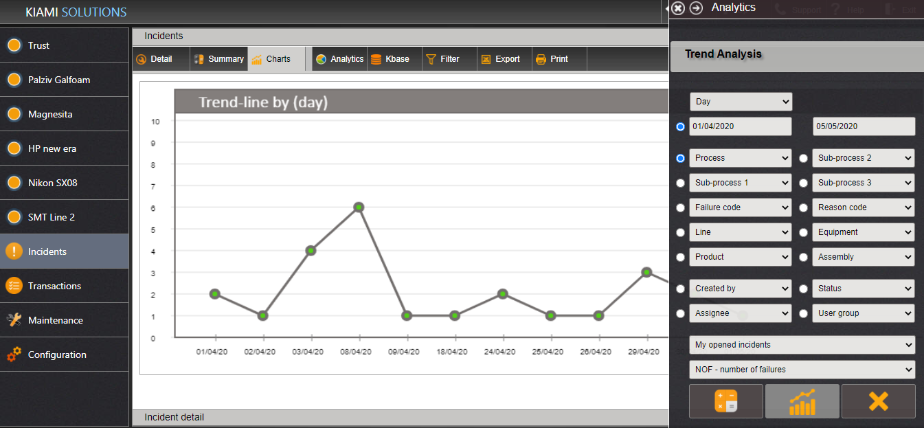
Kiami’s
Virtual Expert
EXPERT WIZARD for FAST DIAGNOSIS
takes you through the complex troubleshooting process
FAST DIAGNOSIS
OPTIMIZATION
ANALYTICS
REPAIR OPTIMIZATION
constantly optimizes root-cause analysis, minimizing time and parts’ costs
PREDICTIVE ANALYTICS
identify failures’ patterns and generate automatic alerts
KIAMI
WRAPPED-UP WITH AN INTUITIVE, SUPER-EASY USER INTERFACE!
8

Slide 9


Case Study:
Pharma Site
Cut Downtimes & Repair Times
Reduce Calls to
Maintenance & IT
50%
40%
Shorter New Technicians’ Learning Curve
(9 > 6 months)
Technical Manpower Cost Saving:
6 out of 30
KIAMI
9

Slide 10
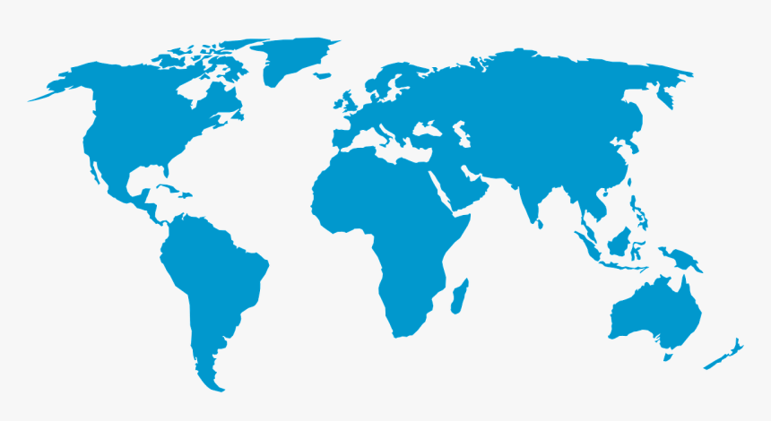

Case Study:
Electronics
Global Knowledge Collaboration
Preserve Experts’ ‘Know-How’
Parts Costs’ Reduction
Technical Manpower Cost-Saving:
3 out of 20
20%
KIAMI
AND IMPPROVED EFFICIENCY AND QUALITY!
10

Slide 11
Customers
Feedbacks
SHAI NIGRI, NIKON’S SITE MANAGER:
“Collaboration of troubleshooting best practices between
the sites has a major importance for a global company”
ELON SHAKED, MAINTENANCE MANAGER:
“The implementation was a remarkable process, that
helped us preserve technicians’ years of experience,
and become more professional and collaborative”
OFER KLEIN, OPEX DIRECTOR:
“I saw many troubleshooting solutions in the last years,
but Kiami’s solution is on another level!”
KIAMI
11

Slide 12
Let’s Start!
Configure your plant
Train your teams
Start working
Enjoy the benefits!
JOIN US TODAY!
ARIE MAOR, CEO
Mail: ARIE.MAOR@KIAMI-SOLUTIONS.COM
Cell: +972-54-8885706
KIAMI
www.kiami-solutions.com
12

Slide 13
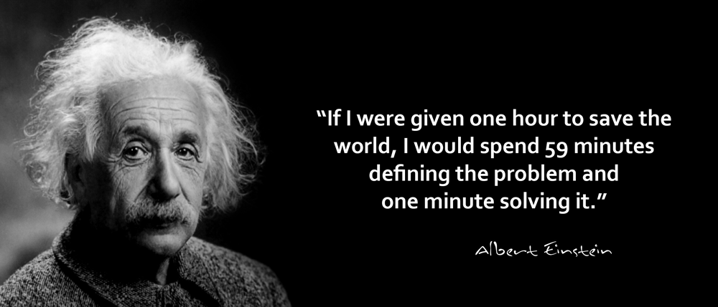
About Kiami
THANK YOU
ARIE MAOR, CEO
Mail: ARIE.MAOR@KIAMI-SOLUTIONS.COM
Cell: +972-54-8885706
KIAMI
www.kiami-solutions.com
13

